Slide 1

WEB SCRAPING

Slide 2
WHAT IS WEB SCRAPING ?
Web scraping, also known as web harvesting or web data extraction, involves extracting data from websites. Most of this data exists in an unstructured format within HTML pages.
The goal is to convert this unstructured data into a structured format (such as a spreadsheet or a database) so that it can be easily analyzed and utilized.
Web scraping can be done using various methods, including online services, APIs provided by websites, or custom code written specifically for scraping.

Slide 3

Problem Statement & Objectives
In today's digital age, there is an abundance of data available on the internet across various domains such as e-commerce, social media, news, research, and more. Businesses and organizations can leverage this data to gain valuable insights, improve decision-making, and enhance their competitive edge. However, accessing and extracting this data manually can be time-consuming and inefficient. Therefore, the need for automated web scraping solutions arises to gather and process large volumes of data from the web efficiently.
Objectives
The objective of the web scraping project is to create a robust and scalable solution for accurately extracting relevant data from target websites. The project aims to achieve the following key objectives:
Data Collection: Develop scripts to scrape data based on specific criteria like keywords, categories, and date ranges from target websites.
Data Extraction: Extract structured data elements such as text, images, URLs, metadata, prices, ratings, and reviews using web scraping techniques.
Data Cleaning: Preprocess the scraped data to remove noise, duplicates, HTML tags, and irrelevant content, ensuring it's in a structured format suitable for analysis.

Slide 4
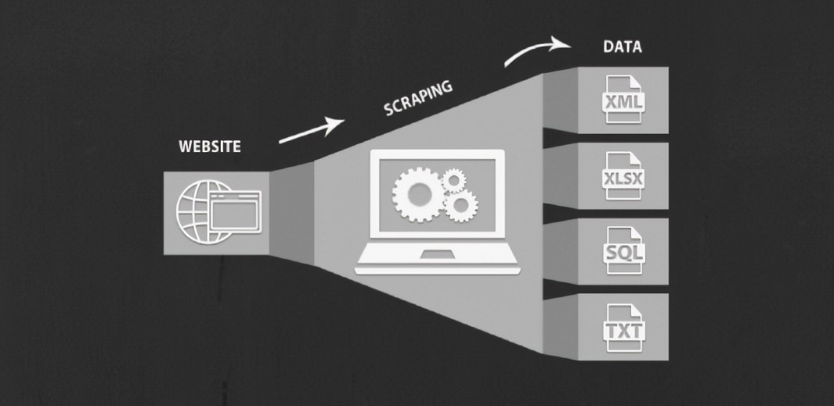
HOW DOES IT WORK ?

Slide 5
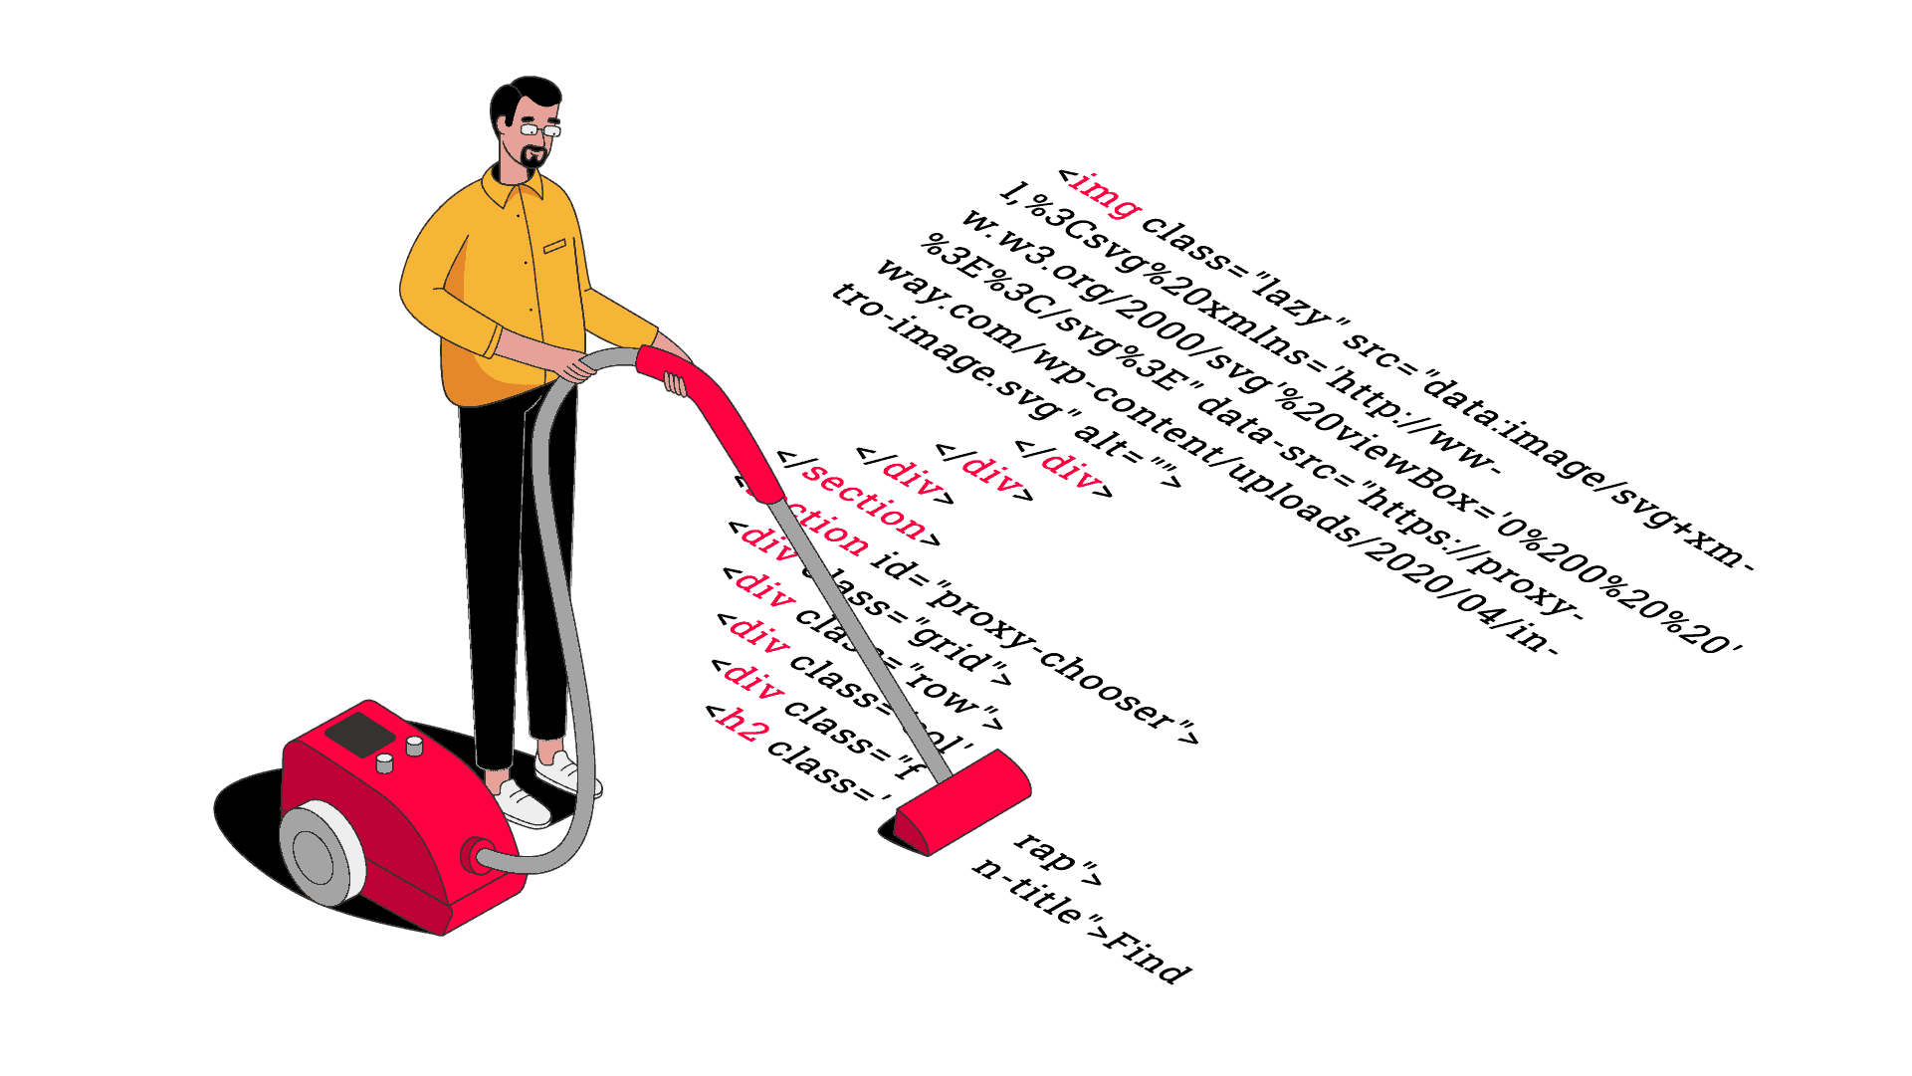
WHAT’S A PARSER ?

Slide 6

WHAT’S PROMPT SCRAPING ?

Slide 7
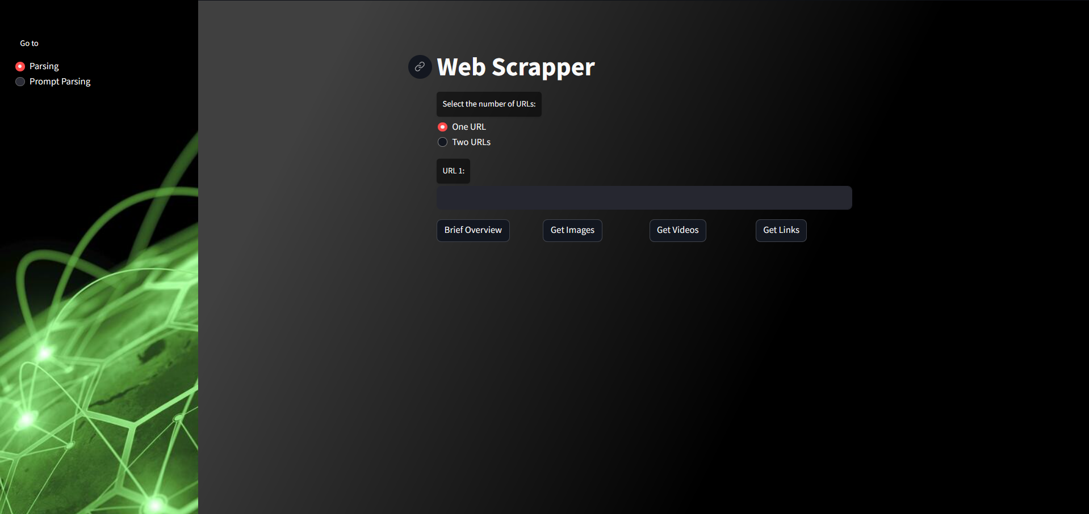
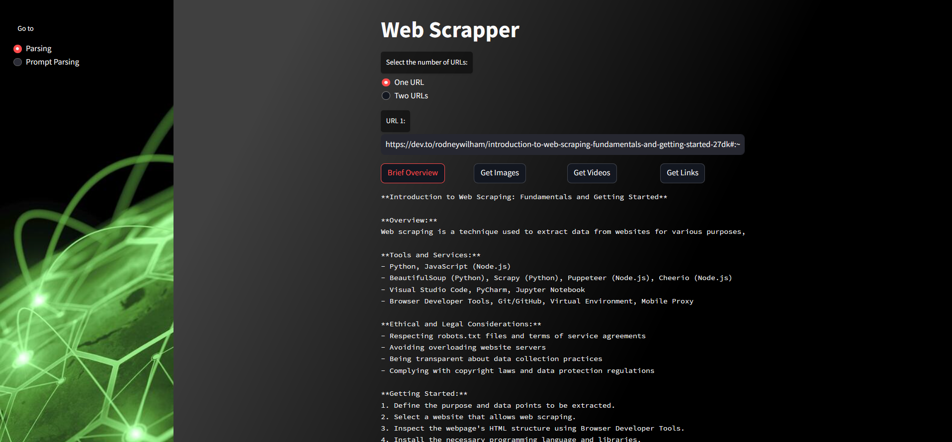
Web Application view :

Slide 8
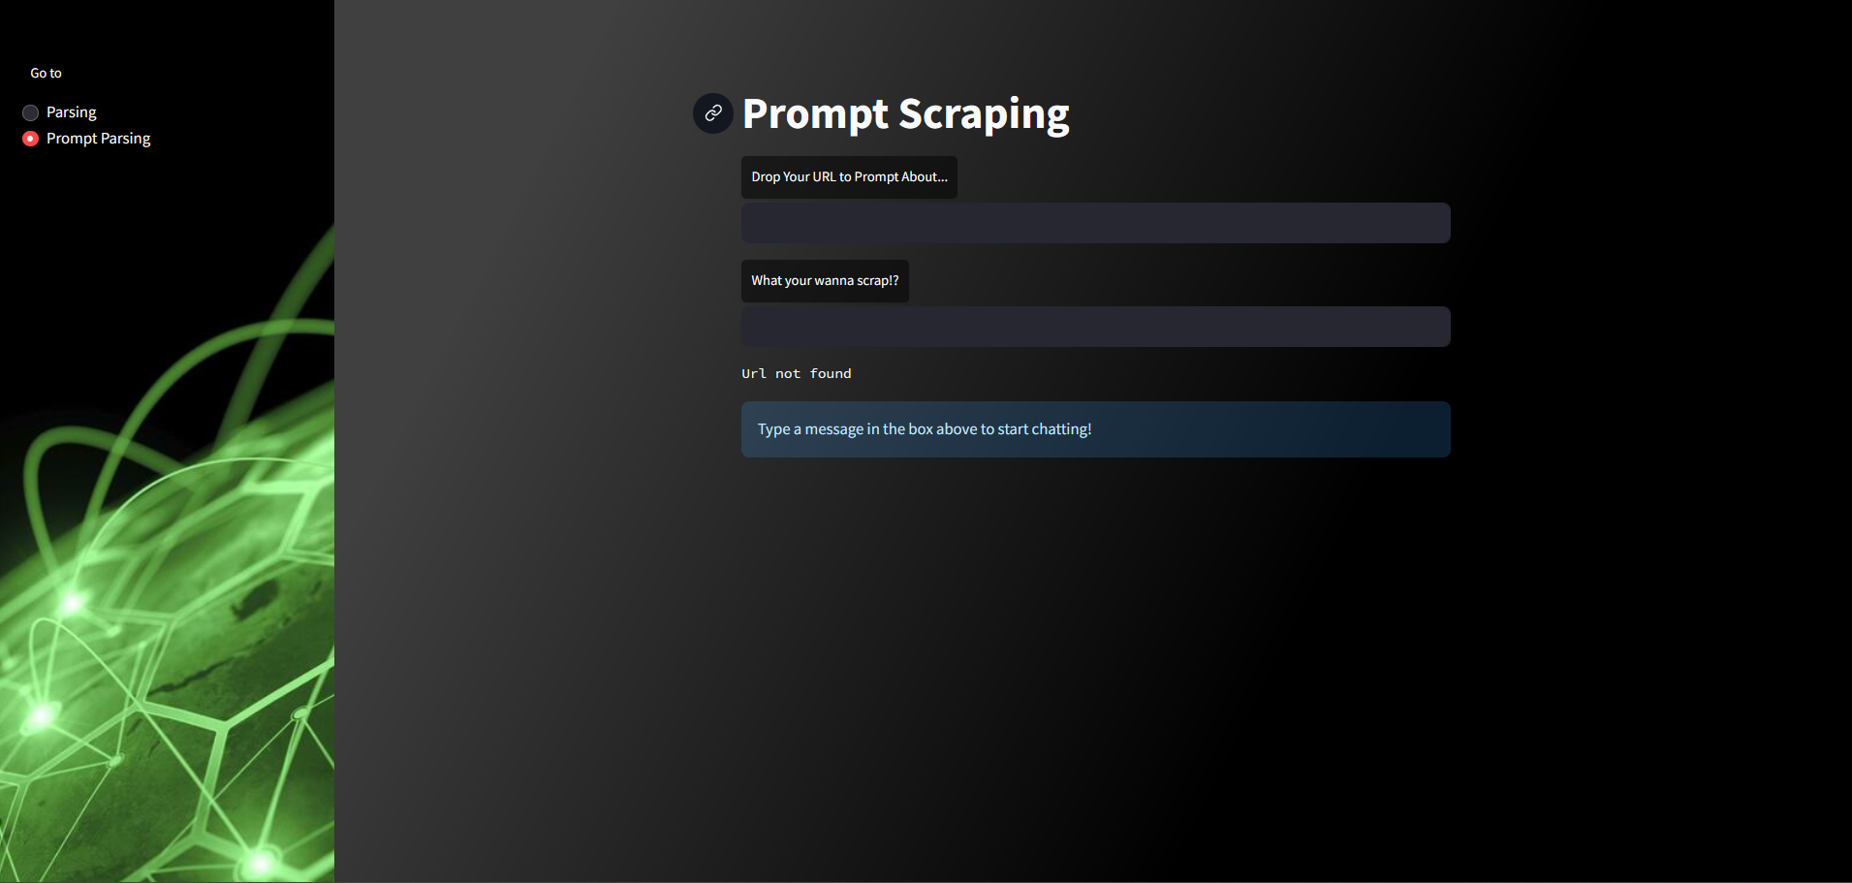
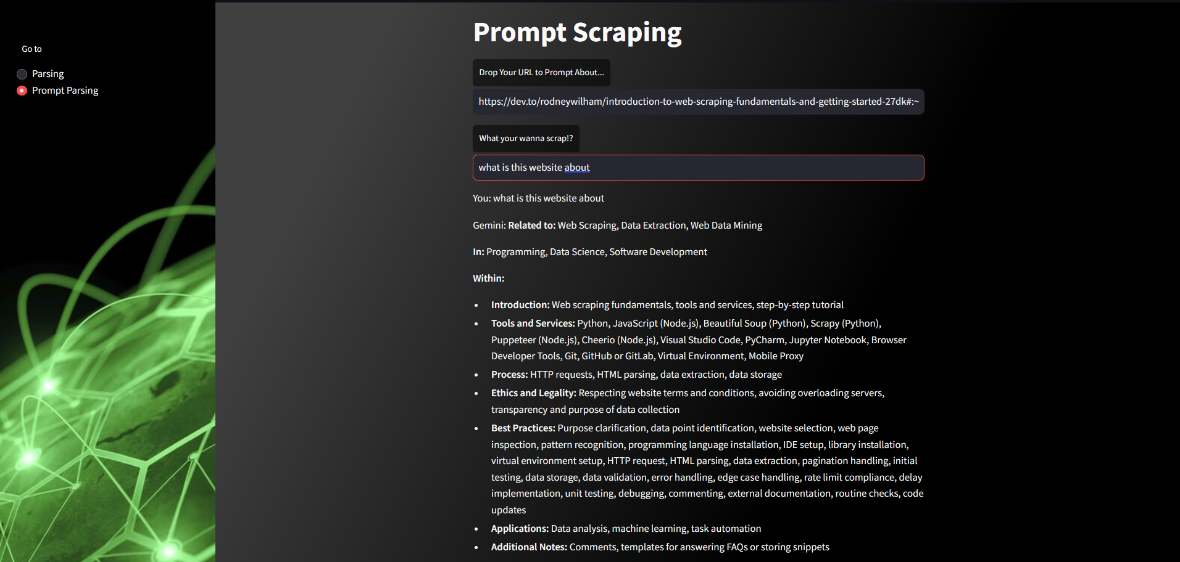
Web Application view :

Slide 9
REAL-WORLD APPLICATIONS OF WEB SCRAPING
Market Research
News Monitoring
Academic Research
Data Science and Machine Learning

Slide 10
NEED OF WEB SCRAPING
Efficiency: Automate data collection, saving time and effort compared to manual methods.
Cost-Effective: Collects data at a lower cost compared to purchasing pre-built datasets.
Scalability: Can handle large volumes of data from multiple websites efficiently.
Data Insights: Provides valuable data for market research, price comparison, and more.

Slide 11
SCOPE
Data Variety: Web scraping isn't limited to text data. It can target and extract various information types from websites, including:
Textual Content: Articles, product descriptions, reviews, social media posts, news headlines - the list goes on.
Structured Data: Prices, ratings, stock information, financial data - any information presented in a well-defined format.
Images and Multimedia: Scraping product images, videos, or other visual content from websites..
Data Volume: Web scraping's true power lies in its ability to handle large datasets. Scrapers can efficiently collect information from a single website or crawl across numerous websites simultaneously, depending on your needs.
Ethical Considerations: It's important to remember that the scope of web scraping should prioritize ethical practices. Always respect website terms of service, focusing on publicly available data and avoiding scraping private or confidential information.

Slide 12
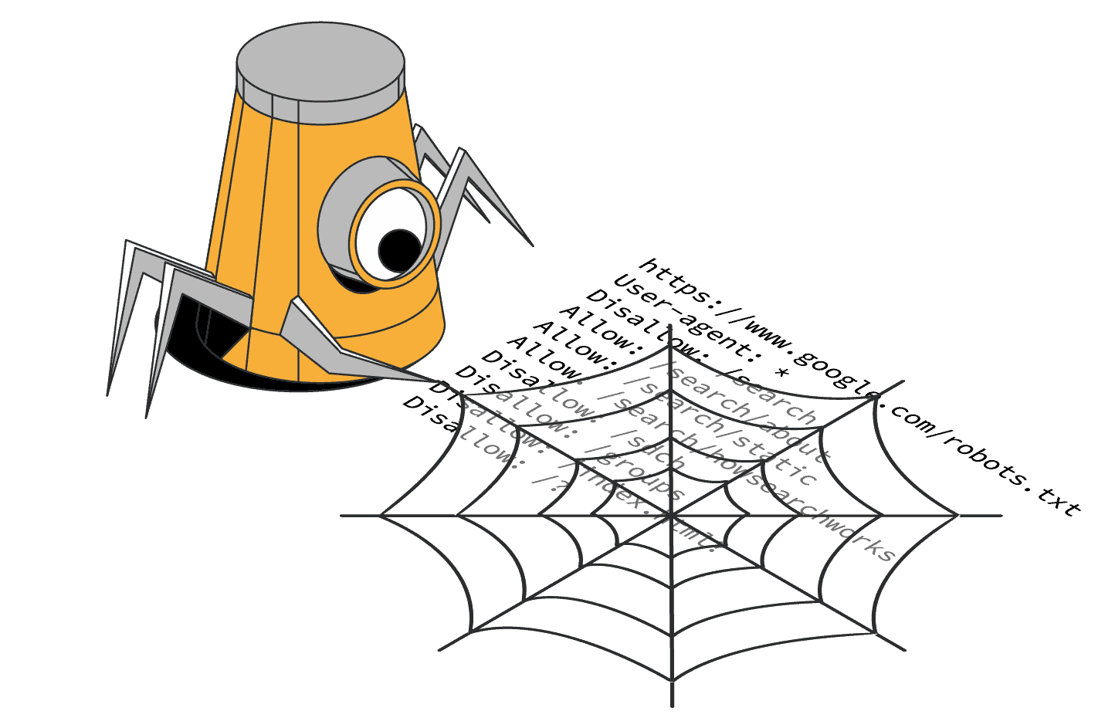
CONCLUSION
Web scraping has revolutionized data collection, offering an automated and efficient way to extract valuable insights from the vast online world.
Its applications span industries, from market research and price comparison to data science and academic research.
As the web evolves, so too will web scraping techniques. Adaptability and responsible practices are key to unlocking the ever-growing potential of data.

Slide 13
THANK YOU

